Slide 1
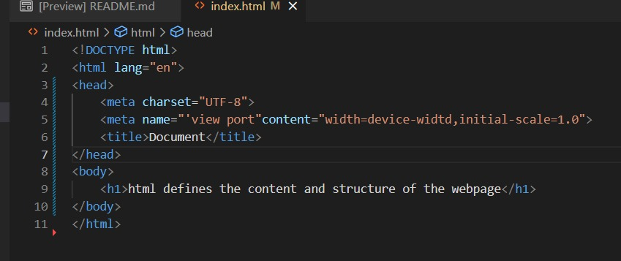
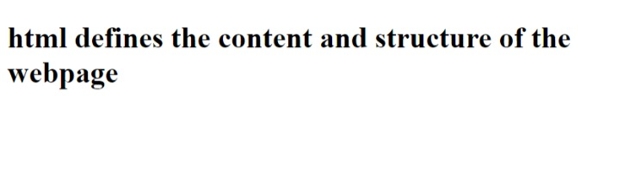
1. Write a simple program in HTML that displays the heading "HTML defines the content and structure of your
website” on the web browser.

Slide 2
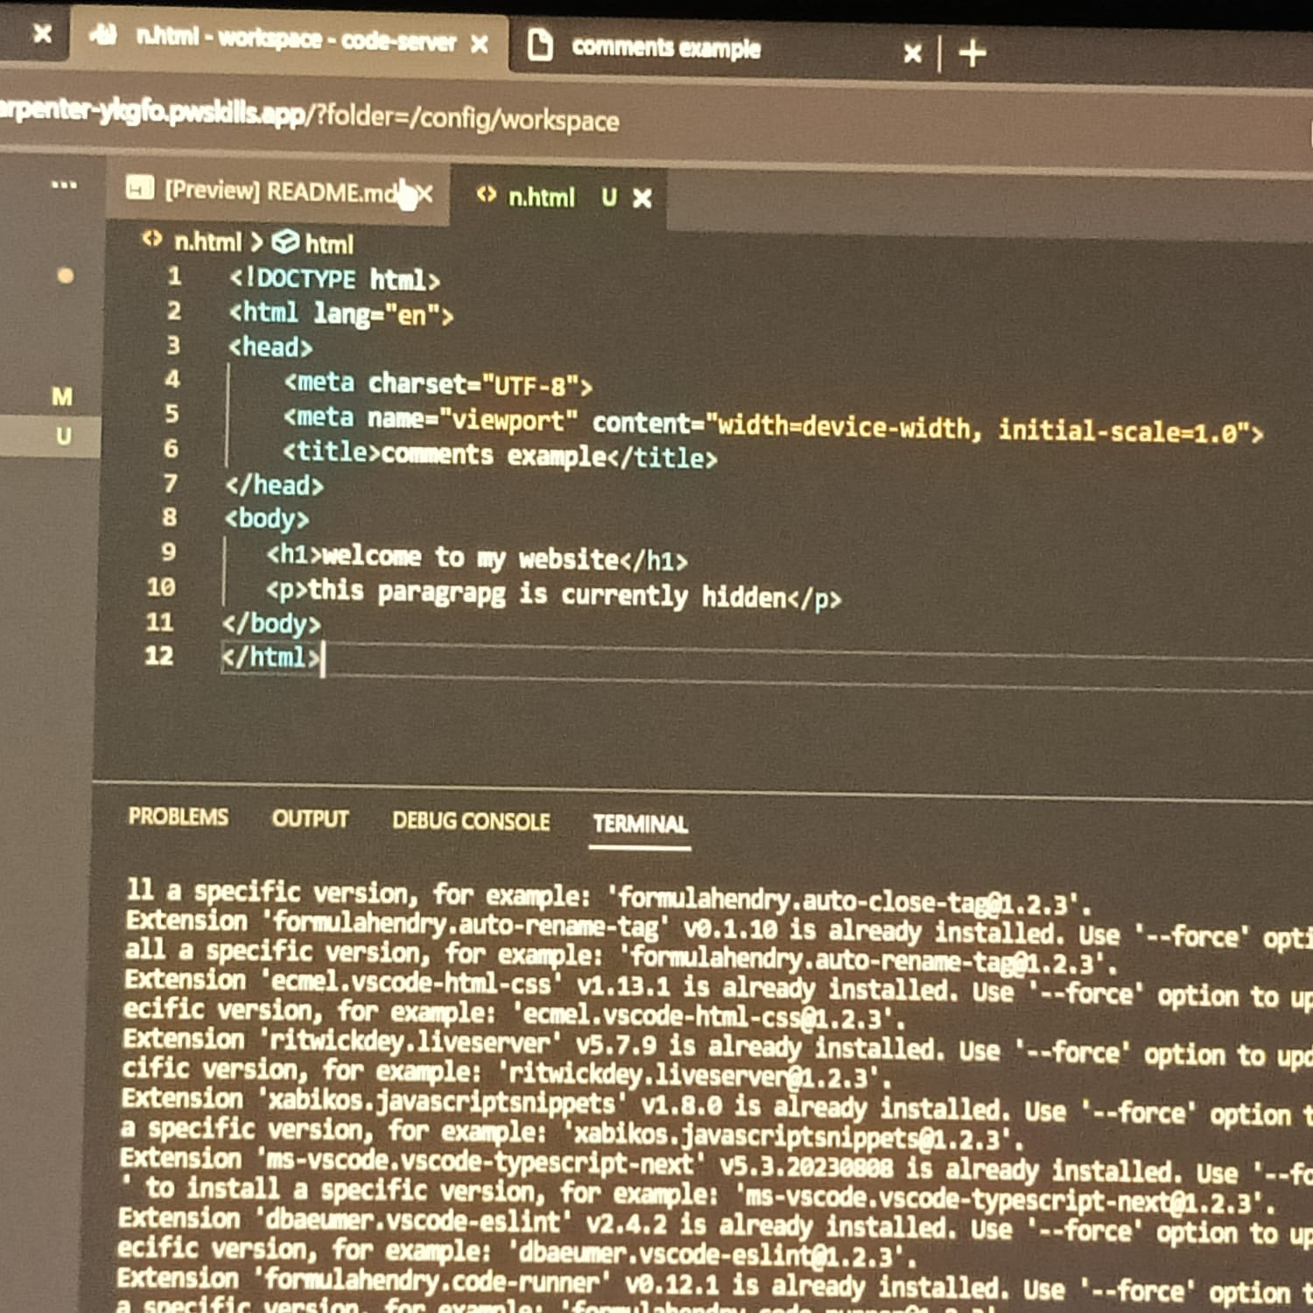
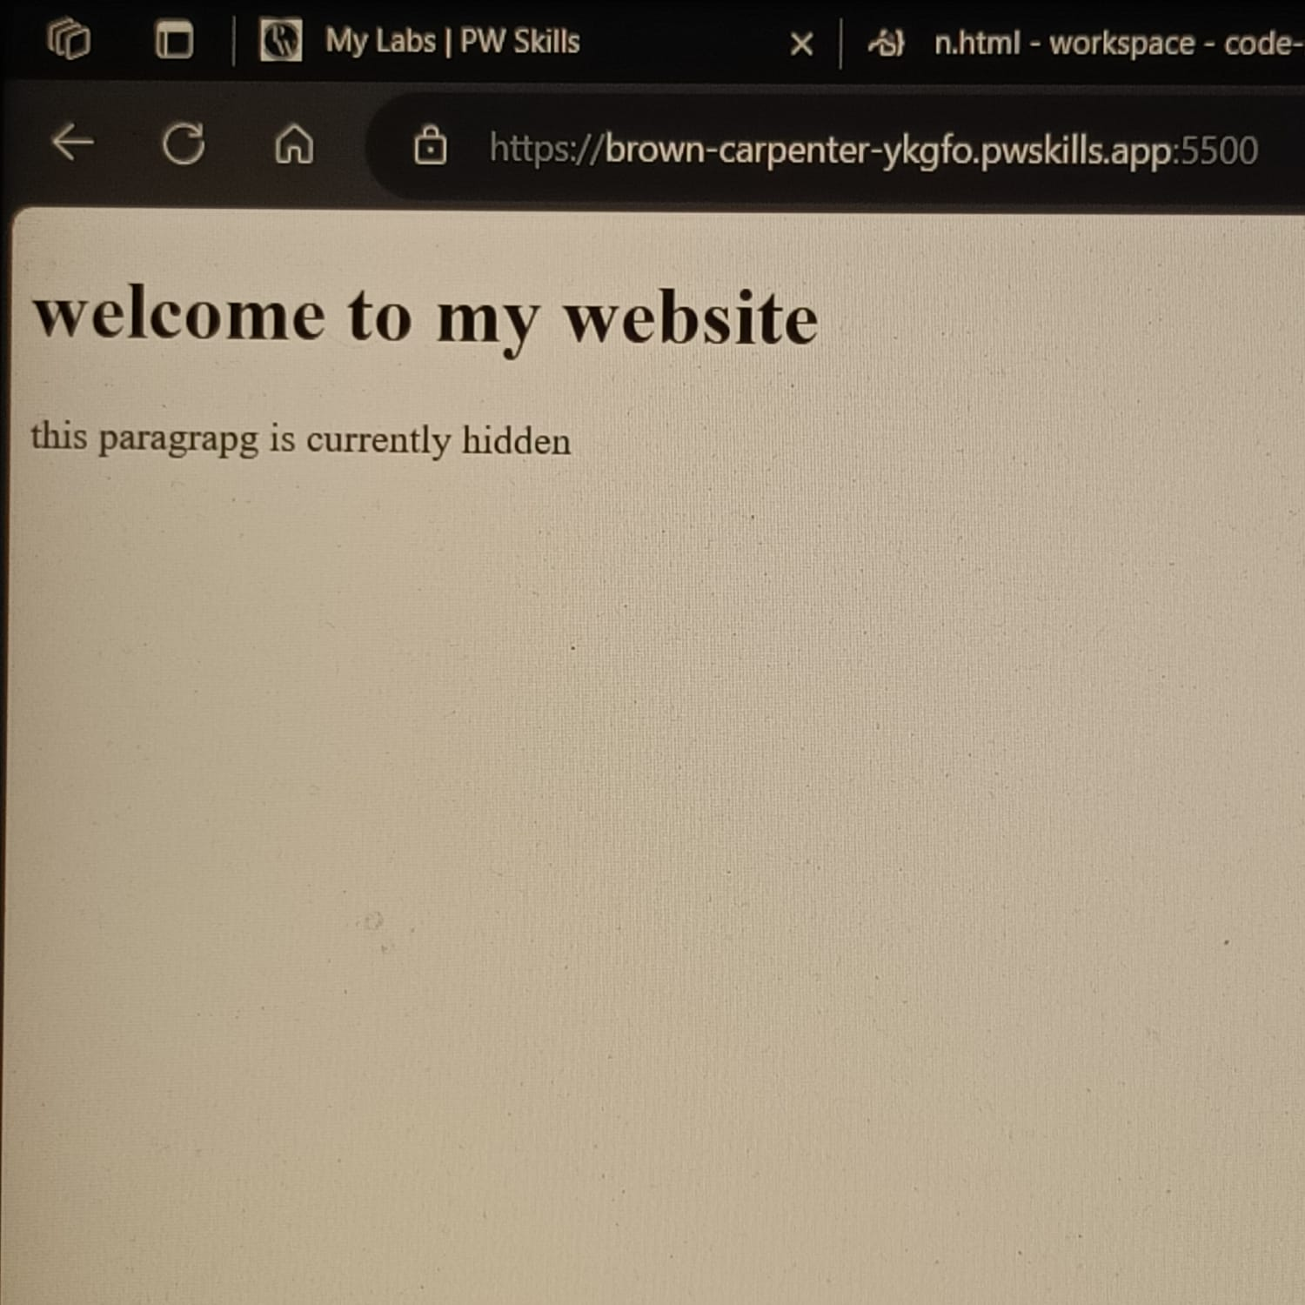
2. Explain the purpose of comments in HTML and provide an example of how to use comments in an HTML
document.
Comments in HTML serve as non-rendered text that provides information about the code for human readers.
They are useful for documenting your code, explaining its purpose, making notes, or temporarily disabling parts
of the code without deleting them. Comments are ignored by browsers and do not affect the rendering of the
webpage.

Slide 3
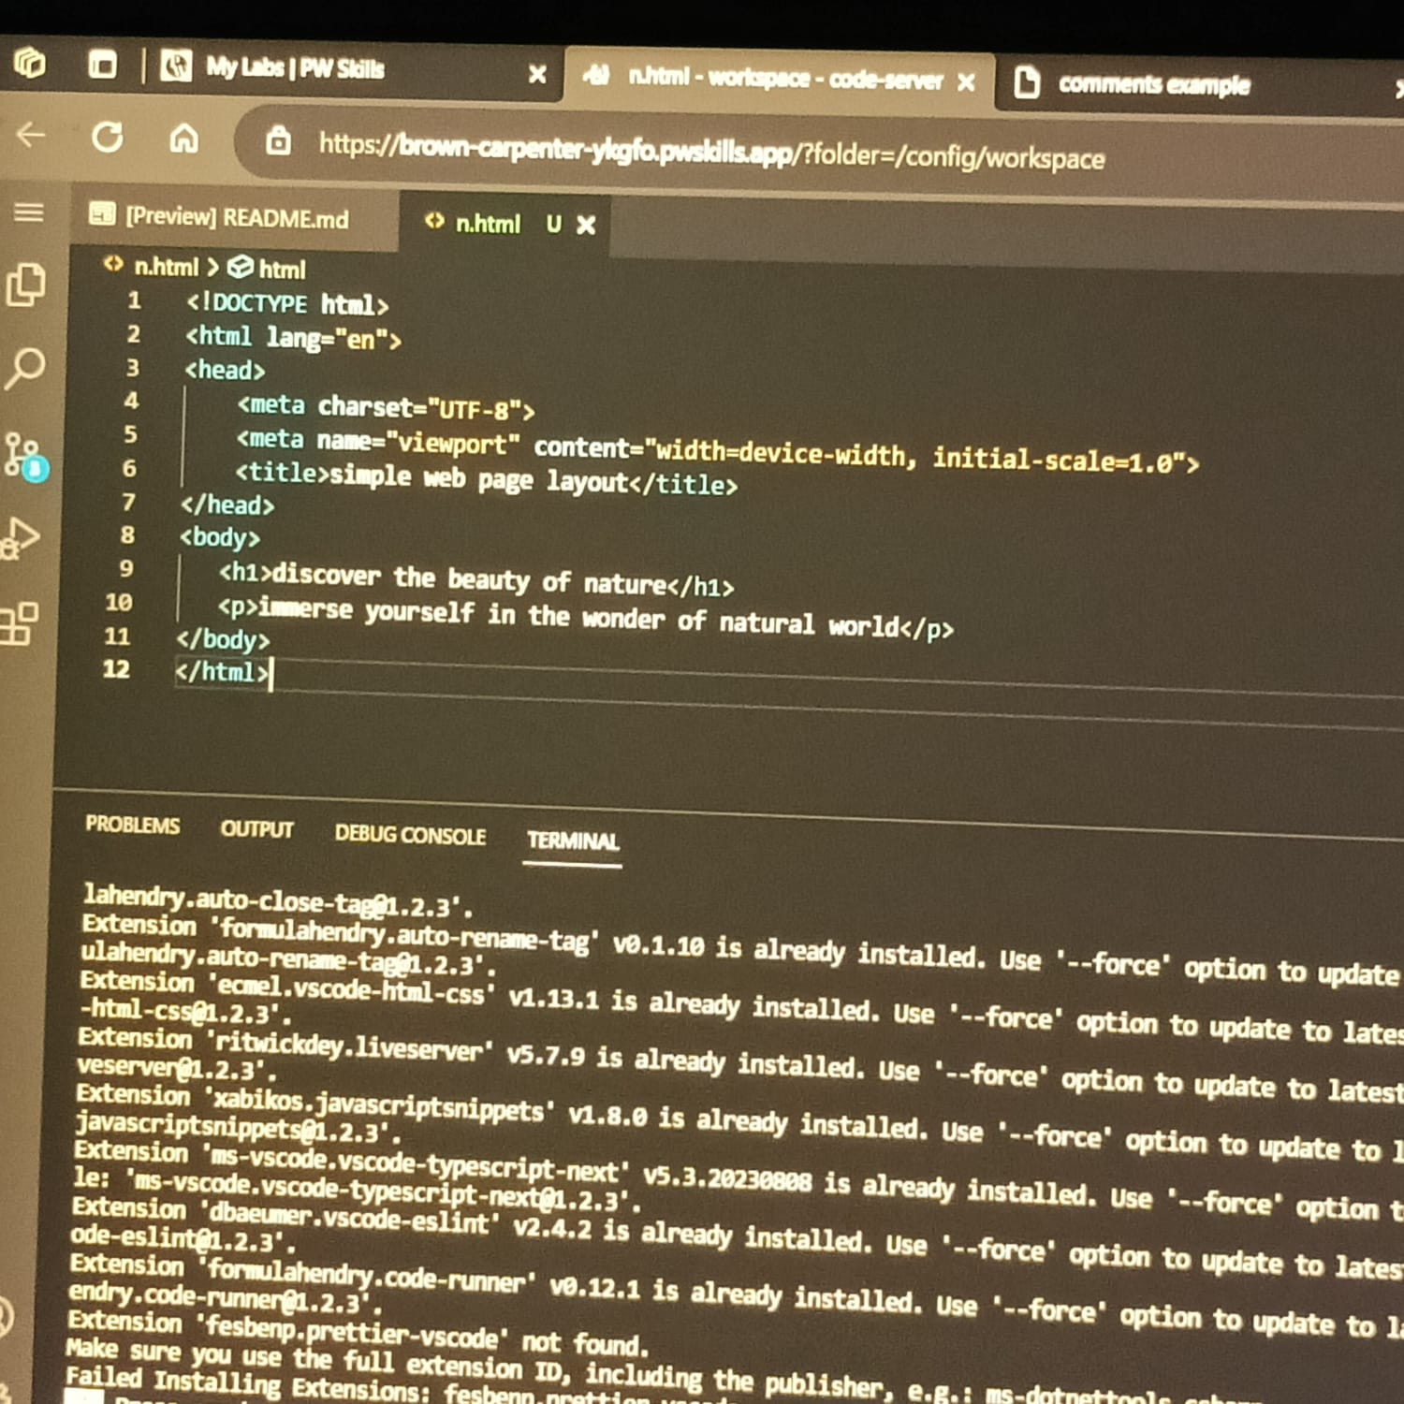
3. Write an HTML program that includes a heading, a paragraph of text, a horizontal line, and a line break.
Arrange these elements to create a simple web page layout.

Slide 4
4. Write a short note on Tag and element with an example.
Tag:
An HTML tag is a snippet of code enclosed within angle brackets ("<" and ">") that defines the purpose and
structure of a specific element on a webpage. Tags are used to instruct the web browser how to display the
content they enclose. Tags usually come in pairs: an opening tag and a closing tag, with the name of the
element enclosed within the tags.
Example of a Tag:
<p>paragraph tag</P>
In this example, <p> is the opening tag, and </p> is the closing tag. The content "This is a paragraph tag." is the
text within the paragraph element.
Element:
An HTML element is a complete unit that includes an opening tag, content, and a closing tag. It represents a
distinct part of a webpage's content or structure. Elements are composed of tags and the content enclosed
between those tags.
Assignment Solution
Example of an Element:
<p>this is paragrapg tag</p>
In this example, <p> is the opening tag, "This is a paragraph element." is the content, and </p> is the closing tag.
Together, they form the complete <p> element, representing a paragraph of text.

Slide 5
5. What is the DOCTYPE Declaration in HTML?
The DOCTYPE declaration in HTML is a special instruction placed at the beginning of an HTML document to
specify the version of HTML being used. It ensures proper rendering and parsing by web browsers. The most
common declaration, <!DOCTYPE html>, indicates the use of HTML5, the latest version of HTML.

